Slide 1
COLLEGE PROJECT PRESENTATION
SONAR
Student Online Navigation & Routing
Never wait in the rain again.

Slide 2



THE PROBLEM
The Commuter's Dilemma
Daily transit causes unnecessary anxiety for students and parents.
Phantom Delays
Missed Rides
Anxious Parents
Waiting indefinitely with zero visibility on arrival times.
Running late by a single minute means a missed class.
Complete blind spot regarding student safety and location.

Slide 3

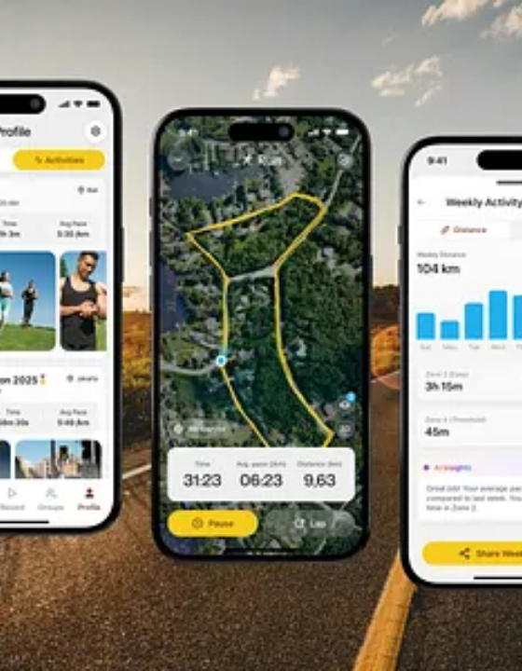
THE SOLUTION
All at one place.
Simple live tracking.
Live Map: Real-time GPS positioning.
Accuracy: Minute-precise arrival estimates.
One Interface: Track every campus route.

Slide 4

CORE FEATURE 1
Continuous Tracking
Four major campus lines converge on the central dashboard.
South & North Lines
Real-time location polling.
East & West Lines
Traffic delay compensation.

Slide 5

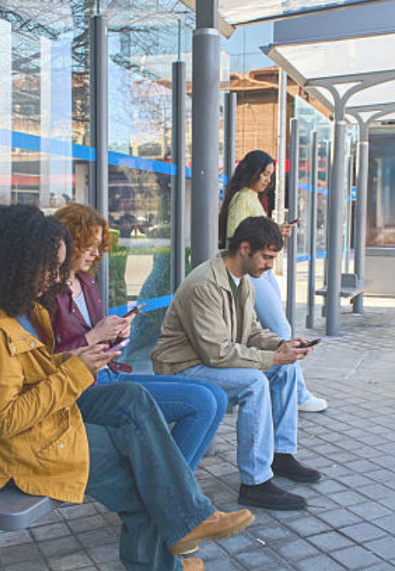

CORE FEATURE 2
Smart Boarding Alerts
Leave home at the exact right moment.
5-Minute Warning
Automated push notification before arrival.
Personalized Stop Focus
Save your default boarding location.

Slide 6
A Better Experience for Everyone
From the campus to the family home.
For Students
For Parents
Maximized morning sleep.
Verified route progression.
Elimination of weather exposure.
Peace of mind for younger commuters.
Guaranteed connection to classes.
Instant awareness of transit delays.

Slide 7







BEHIND THE SCENES
How SONAR Works
A streamlined pipeline from vehicle to student.
1. Telemetry
2. Processing Engine
3. Live Dashboard
Buses transmit live GPS coordinates.
Server calculates accurate arrival ETAs.
Students view seamless map updates.

Slide 8


Current Technology Stack
What We Are Using Now
Note: Mastered in class. Foundation of our system.
Frontend Interface
Backend Server
HTML & CSS: Visible structure, layout, and styling.
Node.js: Runs server-side JavaScript for background operations.

Slide 9
Project Roadmap
Technologies We Will Use Next
Note: Scaling up for live tracking and traffic.
Real-Time Data
Performance
IoT Telemetry: Hardware pipeline capturing live GPS coordinates.
Redis Cache: Fast storage prevents morning rush crashes.
WebSockets: Instant live map updates without refreshing.
Geofence Triggers: Spatial math detects buses for alerts.

Slide 10



Phased Campus Deployment
Moving from prototype to college-wide standard.
PHASE 1
PHASE 2
PHASE 3
Pilot Testing
Core Integration
Family Portal
1 Route, 50 Beta Testers.
All campus lines active.
Parent access and notifications.

Slide 11
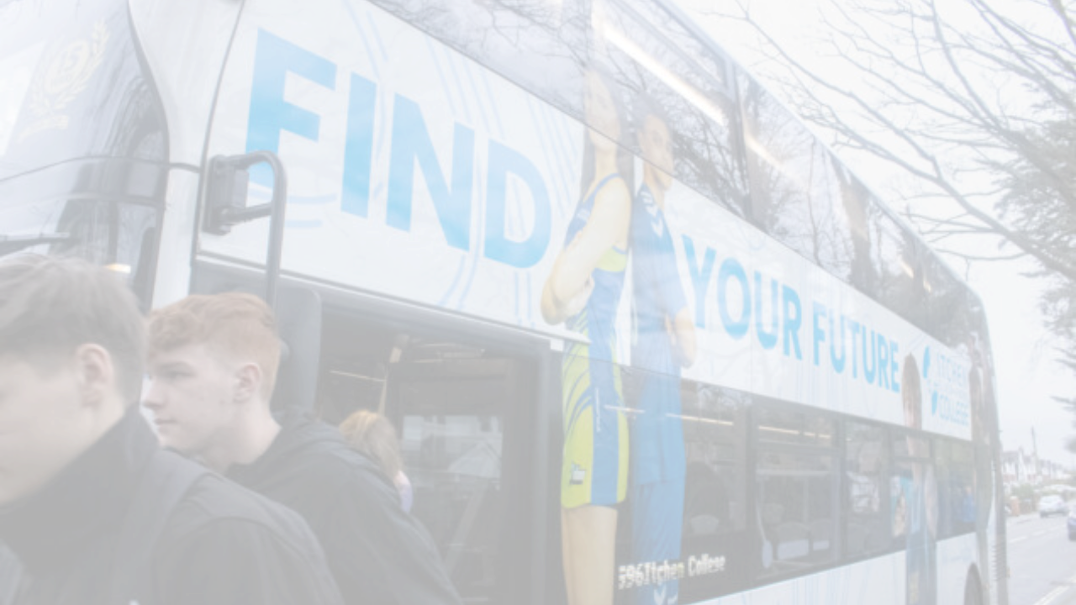

Ready for a smarter commute?
Thank you. Open for Q&A.
SONAR PROJECT TEAM

